Slide 1




Web Enumeration
PHPUnit Attack
Giorgi Akhalaia
Tbilisi, 2022

Slide 2

Overview
Web Enumeration Fundamentals
Web Fuzzing
CVE Explanation
Tools
Exploit lookup
Machine: php-unit

Slide 3

Web Penetration Testing 2
For Educational Purposes Only
In either case,
hacking without a customer’s explicit permission and direction
is a crime.
Notes:
BROWSERS
The simplest way to start website enumeration is to open a browser to popular directory names and note the HTTP response code. For example:
http://www.example.tld/admin (401)
http://www.example.tld/cgi-bin (403)
http://www.example.tld/test (404)
http://www.example.tld/logs (200)
http://www.example.tld/bin (200)
http://www.example.tld/content (402)
http://www.example.tld/scripts (404)
http://www.example.tld/.well-known/
NMAP
Nmap has scripts you can use to enumerate information from popular web applications, including:
nmap --script=http-enum <target>
nmap --script=http-drupal-enum <target>
nmap -–script=http-php-version <target>
nmap --script=http-webdav-scan <target>
nmap --script=http-wordpress-enum <target>
DIRBUSTER
Dirbuster is a GUI tool that ships with Kali Linux. Created by the OWASP group, it uses word lists to search for possible directory names on websites.

Slide 4
Web Enumeration
Website enumeration involves discovering resources that the web server is using, as well as the underlying technology that the web server is running on.
This information can help you choose more effective vectors to use in an attack, as well as exploit vulnerabilities in specific versions of web server software.
You can use several tools to enumerate websites, including a browser, Nmap, Metasploit, dirbuster, and many more.

Slide 5

Web Fuzzing
Fuzzing:
Fuzz testing or Fuzzing is a Black Box software testing technique, which basically consists in finding implementation bugs using malformed/semi-malformed data injection in an automated fashion.
The purpose of fuzzing relies on the assumption that there are bugs within every program, which are waiting to be discovered. Therefore, a systematic approach should find them sooner or later.

Slide 6

Black Box / White Box Hacking?

Slide 7
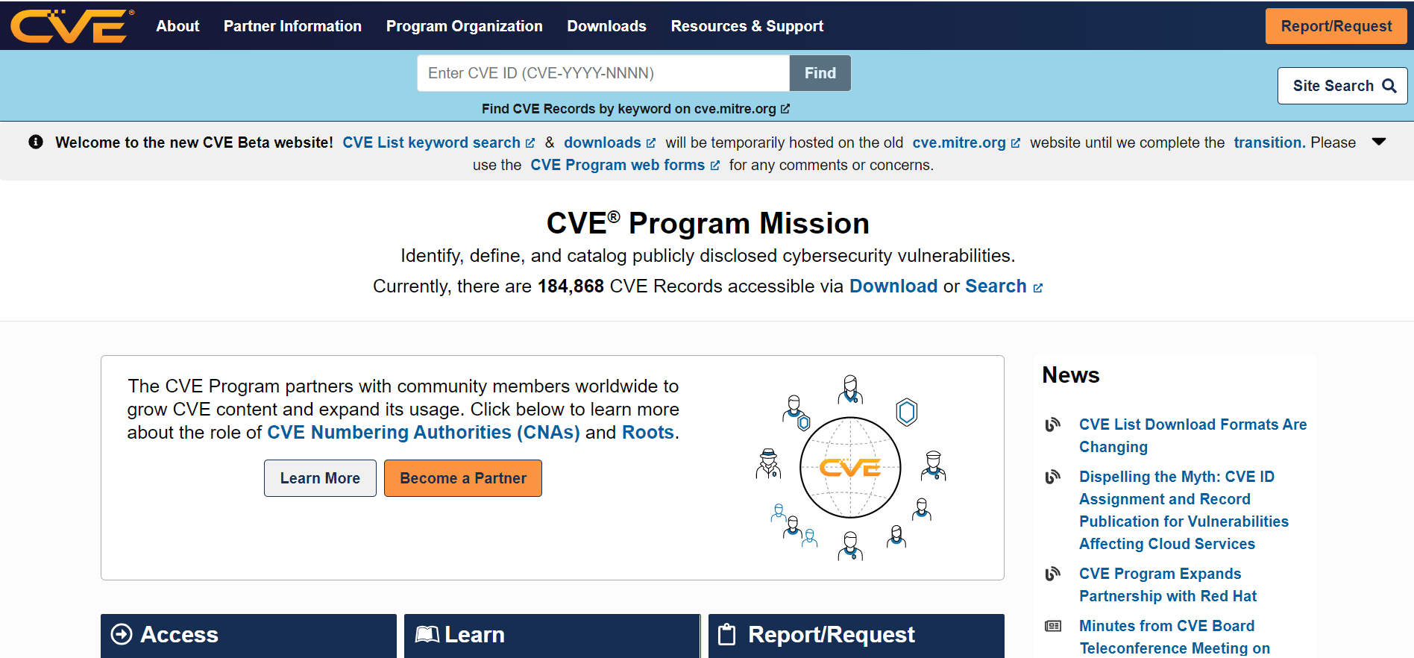
CVE
Common Vulnerabilities and Exposures
https://cve.org
CVE stands for Common Vulnerabilities and Exposures.
CVE is a glossary that classifies vulnerabilities.
The glossary analyzes vulnerabilities and then uses the Common Vulnerability Scoring System (CVSS) to evaluate the threat level of a vulnerability.
The CVE glossary is a project dedicated to tracking and cataloging vulnerabilities in consumer software and hardware.
It is maintained by the MITRE Corporation with funding from the US Division of Homeland Security.
Notes:
https://www.iana.org/assignments/media-types/media-types.xhtml

Slide 8
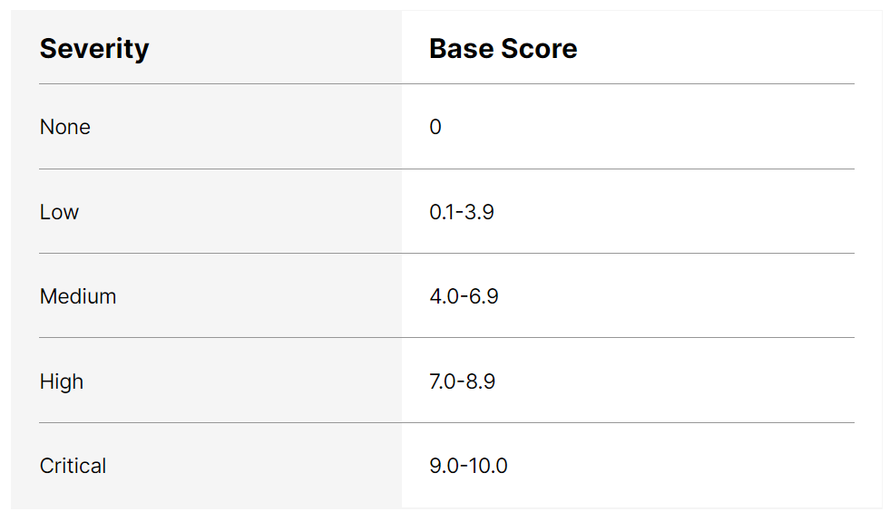
CVSS
Common Vulnerability Scoring System
https://cve.org
The CVSS is one of several ways to measure the impact of vulnerabilities, which is commonly known as the CVE score.
The CVSS is an open set of standards used to assess a vulnerability and assign a severity along a scale of 0-10.
The current version of CVSS is v3.1, which breaks down the scale is as follows:
The CVSS standard is used by many reputable organizations, including NVD, IBM, and Oracle.
Notes:
https://www.iana.org/assignments/media-types/media-types.xhtml

Slide 9
CVE Identifiers
CVE Flow
When vulnerabilities are verified, a CVE Numbering Authority (CNA) assigns a number.
A CVE identifier follows the format of — CVE-{year}-{ID}. There are currently 114 organizations, across 22 countries, that are certified as CNAs. These organizations include research organizations, and security and IT vendors.
CNAs are granted their authority by MITRE, which can also assign CVE numbers directly.
Vulnerability information is provided to CNAs via researchers, vendors, or users. Many vulnerabilities are also discovered as part of bug bounty programs.
These programs are set up by vendors and provide a reward to users who report vulnerabilities directly to the vendor, as opposed to making the information public.
CVE-{year}-{ID}

Slide 10

CVE Identifiers
CVE Flow
Vendors can then report the vulnerability to a CNA along with patch information, if available.
Once a vulnerability is reported, the CNA assigns it a number from the block of unique CVE identifiers it holds. The CNA then reports the vulnerability with the assigned number to MITRE.
Frequently, reported vulnerabilities have a waiting period before being made public by MITRE. This allows vendors to develop patches and reduces the chance that flaws are exploited once known.
When a CVE vulnerability is made public, it is listed with its ID, a brief description of the issue, and any references containing additional information or reports. As new references or findings arise, this information is added to the entry.

Slide 11
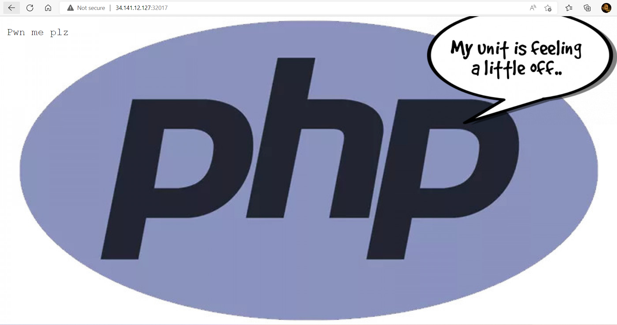
Laboratory: php-unit
Description:
Welcome to the magical world of Adventure of CVE. Explore as much as you can this land of services.
Flag format: CTF{sha256}
Level: Medium
Server: 34.141.12.127:32017
Hints:
Hint 1: Path Traversal

Slide 12
Laboratory: php-unit

Slide 13

Laboratory: php-unit
Dirsearch is an advanced command-line tool designed to brute force directories and files in webservers, AKA web path scanner dirsearch is being actively developed by @maurosoria and @shelld3v
$./dirsearch.py -u http://34.141.12.127:32017 -w ./db/dicc.txt
Notes:
https://github.com/maurosoria/dirsearch

Slide 14
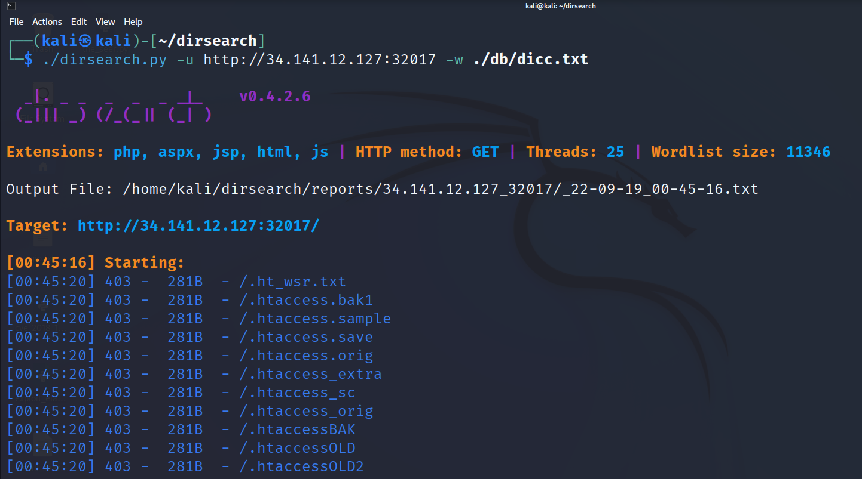
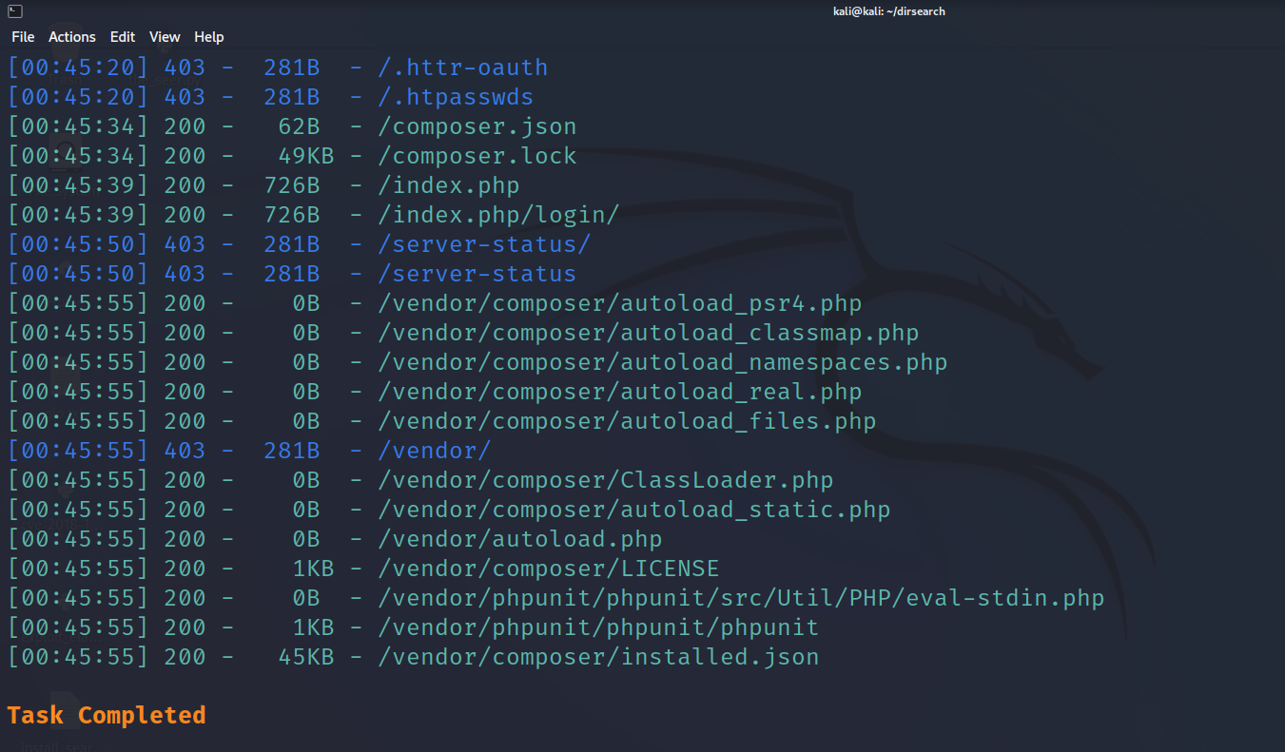
Laboratory: php-unit
Let’s Enumerate by dirsearch

Slide 15

Laboratory: php-unit
Let’s Enumerate by dirsearch
/composer.json
Here we can find version of php-unit
/eval-stding.php
Vulnerable path
Notes:
Usually phpunit is deployed using composer, a very popular dependency manager for PHP. In most cases phpunit isn't required for the production environment, but nonetheless it is installed. Placing composer modules into web accessible directory is another common mistake that allows direct exploitation of this vulnerability.

Slide 16
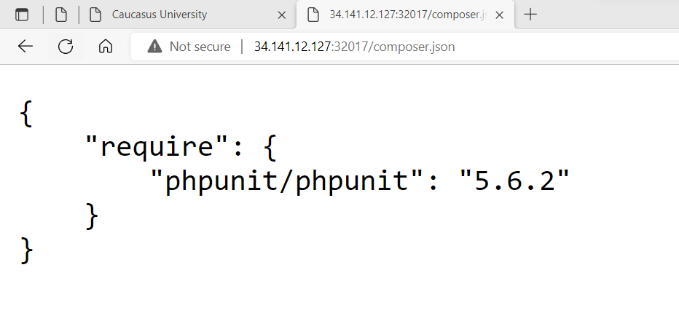
Laboratory: php-unit
Let’s check: /composer.json
Here we can understand that our phpunit is vulnerable

Slide 17
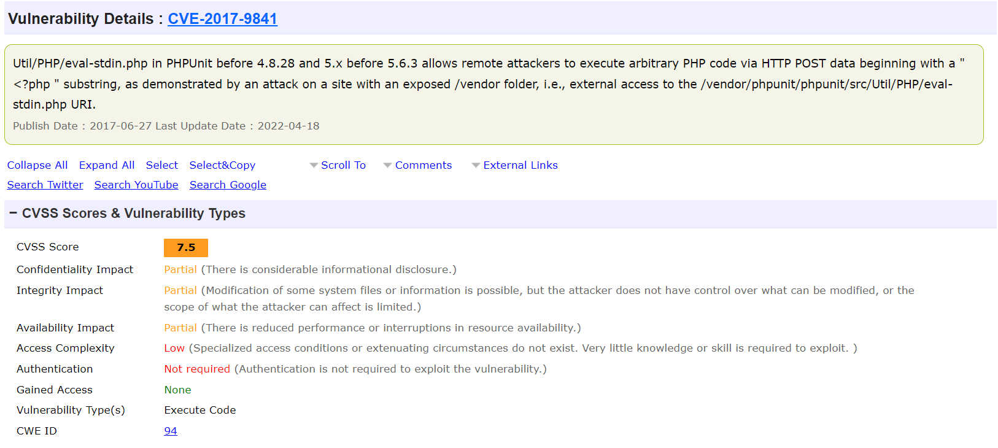
CVE-2017-9841
Our example: version 5.6.2
Notes:
https://www.iana.org/assignments/media-types/media-types.xhtml

Slide 18
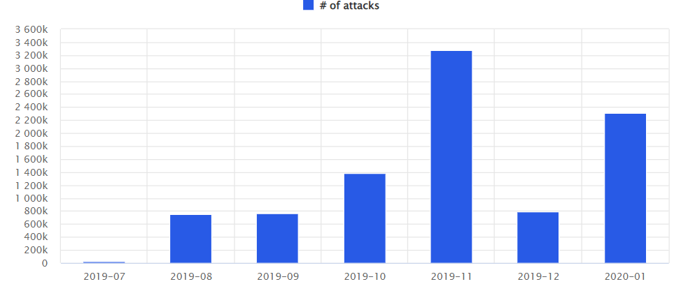
PHPUnit RCE Vulnerability
CVE-2017-9841
As part of a study carried out at Imperva, it was observed around nine million attack attempts to exploit the CVE-2017-9841 vulnerability.
The CVE-2017-9841 vulnerability lets a malicious user remotely run PHP code on fallible websites, by exploiting a breach in PHPUnit.
This can allow the user to, for example:
Access sensitive content on the target’s website (files, database credentials, database content…)
Change files’ content
Send spam
Install malware
Attack attempts by year
2019 – Around seven million in the last six months
2020 – Around two million up until January

Slide 19
The Scope of CVE-2017-9841
Since PHPUnit used by a variety of popular CMS (Content Management Systems) such as WordPress, Drupal and Prestashop, as well as by many modules developed by third parties, the scope of this security breach can be quite wide.
For example, are several known modules that deploy to production – including the PHPUnit framework:
Prestashop: (autoupgrade ,pscartabandonmentpro ,ps_facetedsearch, Gamification, ps_checkout)
WordPress: (Jekyll Exporter plugin, Dzs-videogallery, cloudflare, MediaWiki, Moodle)
Drupal: (Mailchimp/Mailchimp commerce – Drupal published a public service announcement (PSA-2019-09-04) )
To make it clear, even if you patch “PHPUnit” per-se, you’re still vulnerable when using a framework that relies on old versions of it.

Slide 20
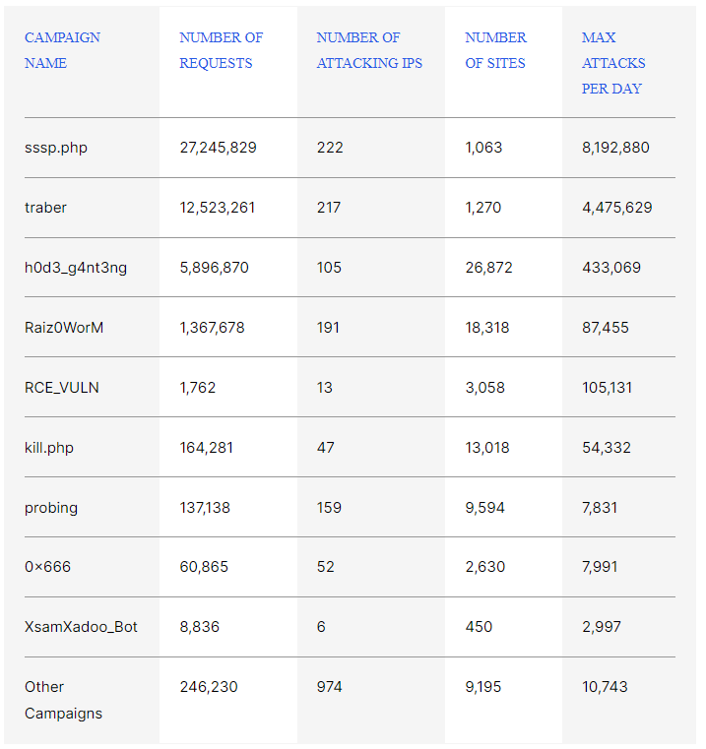
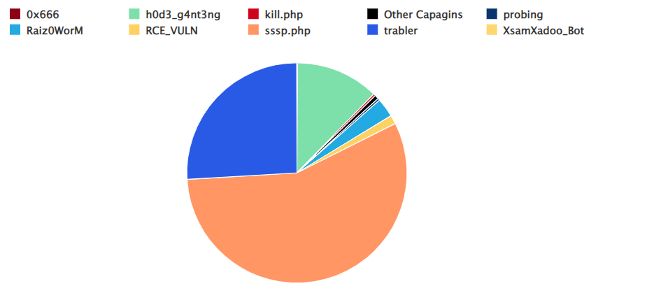
PHPUnit Campaigns Statistics
The Study
A campaign is an attack attempt that uses the same payload and is used by multiple IPs to target multiple sites.
We can see the top two campaigns are sssp.php and traber with a maximum number of eight million and four million attacks per day respectively.
We can see how the campaigns’ attacks are divided by percentage:

Slide 21
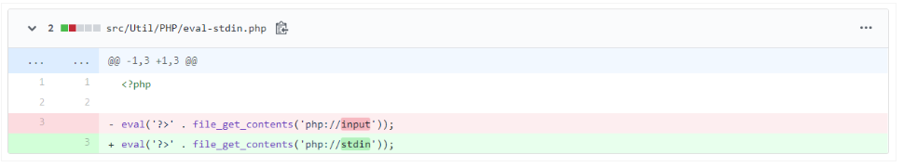
CVE-2017-9841
Dive into the CVE-2017-9841 Details
To understand the root issue leading to the vulnerability, let’s first look at the fix for the PHP-Unit eval-stdin.php file from November 11, 2016:
To explain what php://input vs. php://stdin means, we first need to know what SAPI is. A mechanism that controls the interaction between the “outside world” and the PHP engine, SAPI stands for “Server API”.

Slide 22
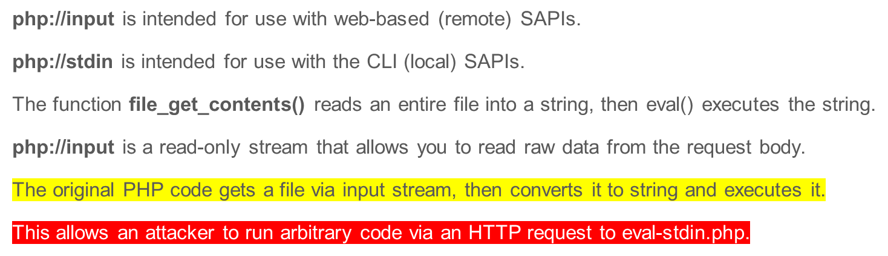
CVE-2017-9841
Dive into the CVE-2017-9841 Details

Slide 23
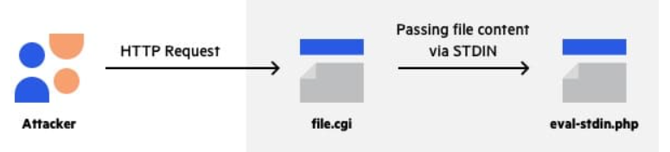
CVE-2017-9841
Flow diagram of the new PHPUnit attack:
A few week after, the several tweets were posted related to the PHPUnit vulnerability saying that an additional vulnerability in PHPUnit versions 7.5.19 and 8.5.1 had been discovered and were yet to be published.
The PHPUnit maintainer confirmed the vulnerability and the CVE request was submitted.
Suspiciously, however, on the same date, the eval-stdin.php was deleted from the PHPUnit repository with the comment – “not used anymore”.

Slide 24
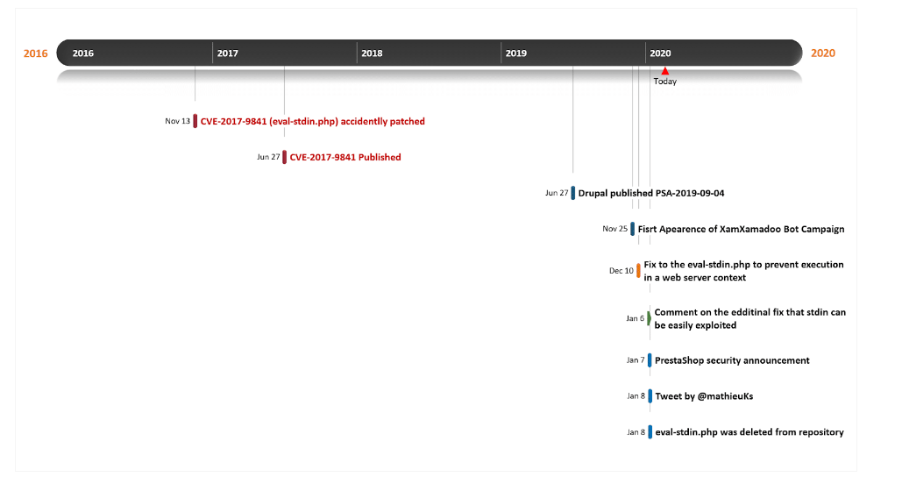
Timeline CVE-2017-9841

Slide 25
Timeline CVE-2017-9841
2016-11-13 – CVE-2017-9841 Vulnerability patched
2017-06-27 – CVE-2017-9841 Vulnerability was published
2017-06-27 – POC was published http://web.archive.org/web/20170701212357/http://phpunit.vulnbusters.com/
2019-09-04 – Drupal published PSA-2019-09-04
2019-11-25 – Start of XsamXadoo Bot Campaign
2019-11-21 – First peak for sssp.php and traber campaign
2019-12-10 – An additional fix to prevent execution in a web server context was released
2020-01-04 – Second peak for sssp.php and traber campaign
2020-01-06 – Comment was added to commit https://github.com/sebastianbergmann/phpunit/commit/33585d982b1e469a921020aa62446f64df63b900
2020-01-07 – PrestaShop security announcement
2020-01-08 – Tweet by Mathieu Ferment (@mathieuKs) about disclosure of new vulnerability in PHPUnit by himself and his team
2020-01-08 – File was deleted from the repository

Slide 26
Timeline CVE-2017-9841
Are we vulnerable ?
Check if the PHPUnit exists on your production webserver
If so, and your PHPUnit version is before 7.5.19 and 8.5.1, it’s possible that you’re vulnerable under specific server configurations
It’s recommended that you remove it (although in some observed cases a removal of the PHPUnit causes unexpected behavior of the webserver), but it’s also possible to block remote access to your /vendor directory which is the root path of the PHPUtil framework.
Are we infected ?
Check for new files under PHPUnit path
Check for core files that have been changed lately

Slide 27
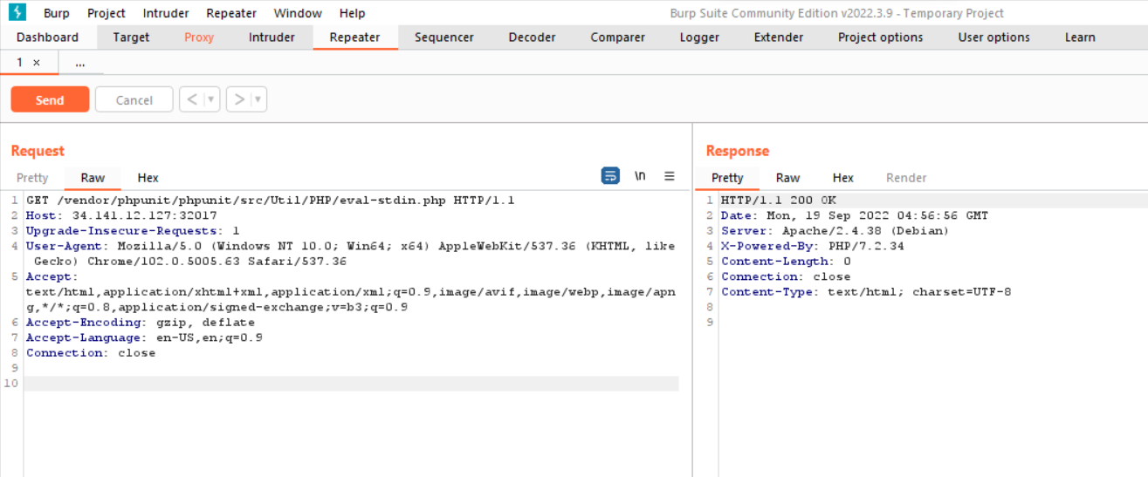
Laboratory: php-unit
Now exploit the vulnerable path:

Slide 28
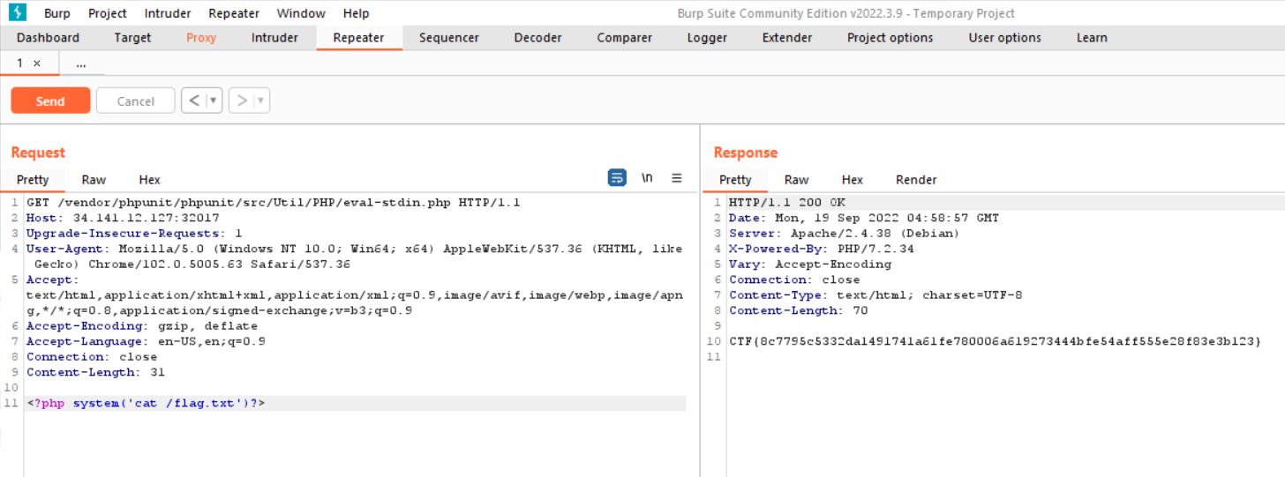
Laboratory: php-unit
Now exploit the vulnerable path:
<?php system('cat /flag.txt')?>
Notes:
CTF{8c7795c5332da1491741a61fe780006a619273444bfe54aff555e28f83e3b123}

Slide 29
Thank you for Attention!
contact: email: gakhalaia@cu.edu.ge
mob: 598 590158

